Slide 1
DevOps Intermediate Training
Markus Winkler
Cloud & DevOps Architect, 10/27/2020

Slide 2
First, let’s recap what we did in V1
We started with atoms and did build more and more complex molecules ☺
We covered quite a few technologies
RESTful APIs, JSON, YAML, Python, Ansible, Docker, K8s, Registries, Git, Jenkins, GitLab and MOADSD-NG
Ansible → Kubernetes → CI/CD

Slide 3
What are we going to do with this profound knowledge?

Slide 4
We create some more molecules!

Slide 5
For that, …

Slide 6
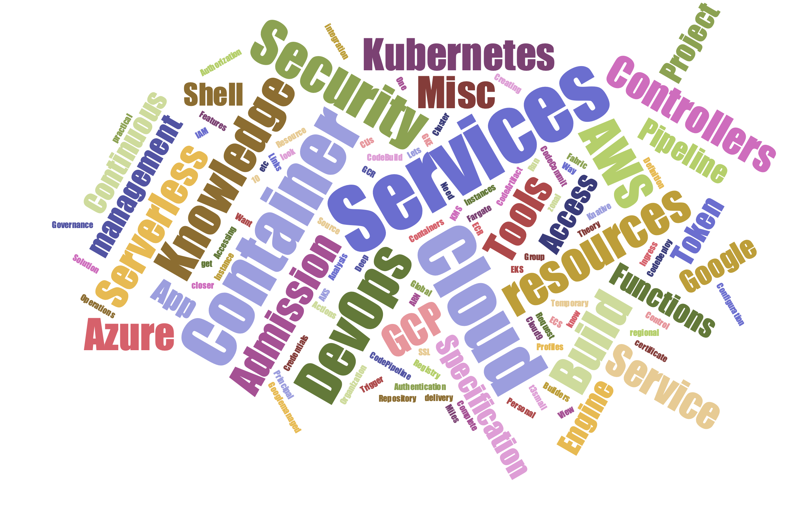
…we do need some more Atoms...
Notes:
https://www.jasondavies.com/wordcloud/
AWS
AWS
AWS
AWS Theory
Services - Container
EKS
ECR
ECS
Fargate
Services - Serverless
Services - DevOps
CodeCommit
CodeArtifact
CodeBuild
Build specification
CodeDeploy
CodePipeline
Knowledge - IAM
Principal
Request
Authentication
Authorization
Actions or Operations
Resources
Instance Profiles
Access Management
Security Token Service
Temporary Security Credentials
Want to know more?
Misc Knowledge, Tools and Services
CLIs
Cloud9
ARN
KMS
t3.small etc.
Deep Links
Azure
Azure
Azure
Services - Container
AKS
App Service
Container Instances
Service Fabric
Container Registry
Services - Serverless
Functions
Services - DevOps
DevOps
DevOps Organization
Project
Pipeline
Continuous delivery
Continuous integration
Pipeline Definition
Misc Knowledge, Tools and Services
Cloud Shell
Resource Group
Personal Access Token
GCP
GCP
GCP
Services - Containers
The Google Way
GKE
Kubernetes Engine Features
The Complete Container Solution
Security
Creating a Cluster
GCR
Container Analysis
Services - Serverless
Cloud Run
App Engine
Cloud Functions
Knative
Services - DevOps
Google Cloud resources
Accessing resources through services
Global, regional, and zonal resources
Project
Cloud Source Repository
Cloud Build
Cloud Builders
Google-managed SSL certificate
Build Trigger
Build Specification
Misc Knowledge, Tools and Services
Cloud Shell
Ingress
Container Control
10 Miles View to Kubernetes Admission Controllers
A closer look at Kubernetes Admission Controllers
Why You Need Admission Controllers
Security
Governance
Configuration management
Let's get practical
Cloud One Container Security

Slide 7
… for being able to build the molecules.

Slide 8

The Molecules
Pipelining in the with C1SC and C1AS
CI/CD with AWS CodePipeline
CI/CD with Azure Pipelines
CI/CD with GCP Cloud Build
Demoing C1 Application Security w/
Containers and Serverless Applications
Demoing C1 Conformity
Demoing C1 File Storage Security
Demoing C1 Smart Check
Demoing C1 Container Control
MOADSD-NG Use-Cases and Best Practices

Slide 9
Prerequisites
Have the following accounts:
AWS
GCP
Azure
CloudOne
Smart Check
Application Security
File Storage Security
Conformity
Container Control
Knowledge of DevOps Foundation Training

Slide 10
Agenda
 | Day 1 | Day 2 | Day 3
9:00am | Introduction | Recap | Recap
10:30am | C1 Conformity Demoing | C1 Application Security Demoing Serverless Apps | MOADSD-NG Use-Cases and Best Practices
11:30am | C1 File Storage Security Demoing | C1 Container Control Admission-Controllers and Demoing | C1 Smart Check Reporting, Deployment Scripts
2:00pm open end | CI/CD w/ AWS CodePipeline | CI/CD w/ Azure Pipelines | CI/CD w/ GCP Cloud Build
Notes:
Red = Not started or In Progress
Green = Mostly Done or Final

